Slide 1
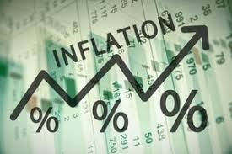
Inflation
Avram Vlad
1718

Slide 2
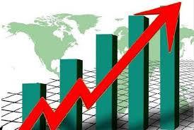
Short introduction
inflation is a sustained increase in the general price level of goods and services in an economy over a period of time. When the general price level rises, each unit of currency buys fewer goods and services; consequently, inflation reflects a reduction in the purchasing power per unit of money – a loss of real value in the medium of exchange and unit of account within the economy.

Slide 3
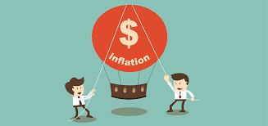
Inflation affects economies in various positive and negative ways. The negative effects of inflation include an increase in the opportunity cost of holding money, uncertainty over future inflation which may discourage investment and savings

Slide 4
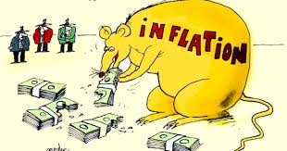
History
Rapid increases in quantity of the money or in the overall money supply (or debasement of the means of exchange) have occurred in many different societies throughout history, changing with different forms of money used. For instance, when gold was used as currency, the government could collect gold coins, melt them down, mix them with other metals such as silver, copper, or lead, and reissue them at the same nominal value.

Slide 5
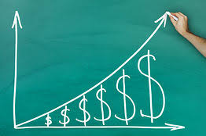
Inflation expectations
Inflation expectations or expected inflation is the rate of inflation that is anticipated for some period of time in the foreseeable future. There are two major approaches to modeling the formation of inflation expectations. Adaptive expectations models them as a weighted average of what was expected one period earlier and the actual rate of inflation that most recently occurred.

Slide 6
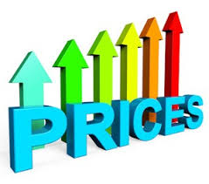
Thank you for your patience

